Slide 1
IFN663 Enterprise Architecture Lecture 2 and 3: Business Capability Modelling
Alistair Barros
Faculty of Science & Engineering
Queensland University of Technology
QUT Gardens Point Campus, 28thJuly & 4th August 2015

Slide 2
Objectives
To understand the notion of business capabilities and their positioning as ways of aligning business with enterprise architecture
To understand the principles of capabilities – what makes properly formed capabilities
To understand how capabilities are collectively structured into a multi-level capability map
To understand the general strategy for alignment of capabilities and enterprise architecture models

Slide 3

Agenda
Introduction to capabilities
Principles of capabilities
Capability maps
Capabilities and business/IT analysis
Introduction to capabilities
Principles of capabilities
Capability maps
Capabilities and business/IT analysis

Slide 4
From Business Strategy to IT Solutions
Business
Strategy
Goals, Policies, Business
Ecosystem, Business Scopes
Enterprise
Business Architecture
Business Scopes to Business Capabilities
Enterprise Alignment Architecture
Business Capabilities to business-to-IT alignment models
Business Process Management
Business process models
Solutions
IT Solutions
Solution architecture models
Notes:
Enterprise Level
Business Strategy
Business Architecture– to narrow what the organization should do (Focus in this unit)
Enterprise Alignment Architecture - to link (align) Business to IT (Focus in this unit)
Solutions Level
Business Process Management
IT Solutions

Slide 5
Business capabilities and strategy
A business capability model is an abstract, compact representation of an organization's business:
independent of organizational structure, processes, people, systems, domains etc.
Designed to enable an organisation to explore and express what it does, so it can plan, understand impact, and change
Enables business and IT strategic planners to make decisions, justified from business
These decisions can guide business and IT architectural changes, and in turn, implementations
Notes:
Business capability is the expression or the articulation of the capacity, materials and expertise an organization needs in order to perform core functions
Articulation – the act of joining this in such a way that motion is possible

Slide 6
Key stakeholders
Business planning teams
Executive steering committees
Business architecture teams
Business/IT transformation initiatives
Enterprise architecture teams
Facilitates business-to-business and
business-to-IT communications
Notes:
Business/IT Transformation initiatives – to replace old systems with the new ones

Slide 7
Business capabilities
Business capabilities can be tied to:
Business strategy and business architecture for business planning
Enterprise architecture for business/IT alignment
Common language and common vehicle for key planning and transformation activities
Not “rocket science” – planning proceeds without specialised language/formalism getting in the way

Slide 8
Business capabilities (cont’d)
One capability map for a business, spanning organisational boundaries (in practice, there can be several, visible only to some LOBs)
Availability of several industry standards:
BIAM
SCOR (Supply Chain Organisation)
A number of industry capability maps through Microsoft
Notes:
LOBs stands for Line of Businesses

Slide 9
What is a business capability?
Describes what a business does, not how, or why
A particular ability or capacity that a business may have or exchange to achieve a specific outcome or purpose
Business, not technical terms
Expressed as noun
E.g. Customer management, Partner management

Slide 10
What is a business capability?
“Capability – an encapsulation of all the relevant attributes, including people, process and technology, that the business relies on for a specific purpose or outcome”
“Capability map – the Rosetta Stone of Business/IT alignment”
- Microsoft Business Service Architecture
- Cutter Consortium
Notes:
Encapsulation – the act of enclosing

Slide 11

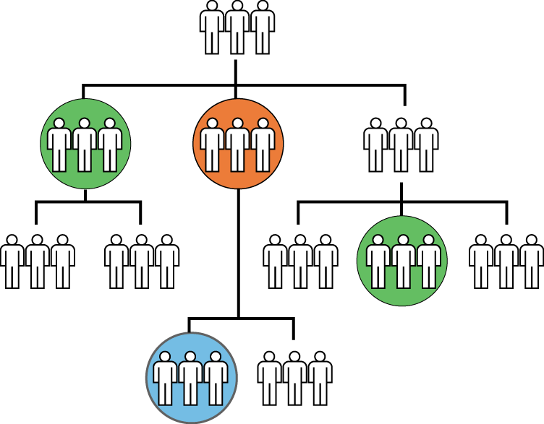
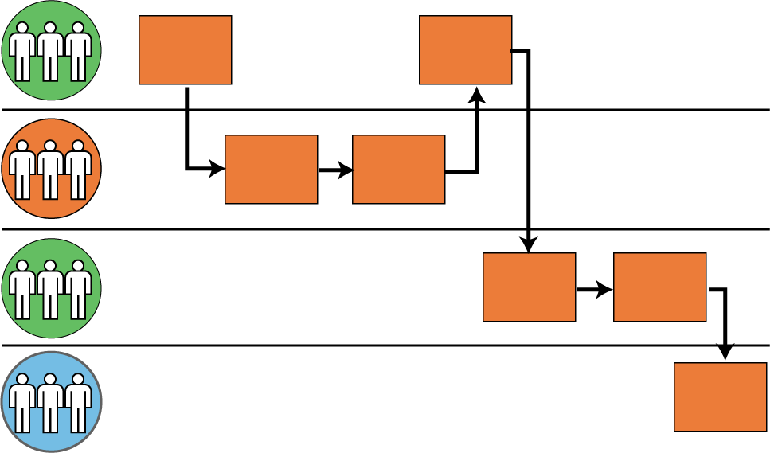
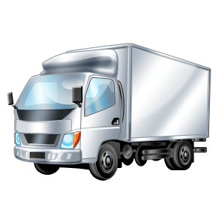
Capabilities relate to key business artefacts
Information
Organization
Capability
Value Streams
Resources
Notes:
Business artefacts
Information
Organization
Resources
Value Streams

Slide 12
Agenda
Introduction to business capabilities
Principles of capabilities
Capability maps
Capabilities and business/IT analysis
Introduction to business capabilities
Principles of capabilities
Capability maps
Capabilities and business/IT analysis

Slide 13
Principles of capabilities
A. Conceptual (abstract)
B. Common across business
C. Aligned to business
D. Not biased to specific business perspective
E. Stable
F. Not redundant
G. Multiple levels

Slide 14
Principles of capabilities
A. Capabilities should be expressed conceptually, i.e. free from
Implementation
Performance
Capacity
Other how, how much, why, where, when etc. considerations
Typically expressed as a noun

Slide 15
Principles of capabilities
B. Capabilities should establish a common view of what a business does
Common activities
Similar objectives
Potentially different LOBs concerned with similar objectives
Common perception as same capability
E.g. Retail banking, mutual funds management and investment management LOBs involve customer and partner management

Slide 16
Principles of capabilities
C. Capabilities should described in a way that they can be aligned to what a business does
Value-chain, org. chart, org. units and resources
Value streams, business services and processes
Business objects
IT applications and resources
KPIs, cost and value measures
Binding agent for understanding business to IT

Slide 17
Principles of capabilities
D. Capabilities should not be biased to particular perspective in business
More than business services, processes, resource information
Alignment to services is good tactical step because they encapsulate other aspects
Adopt completeness measures and processes when defining capabilities
Adopt maturity status for capabilities

Slide 18
Principles of capabilities
E. Capabilities should be stable, not volatile
Essence vs.. manifestation (e.g. deployment, stakeholders involved, product lines, market segments)
Improved capacity and efficiency may retain existing capabilities or create news ones
Changes in business planning and models can trigger new capabilities
E.g. New technology solutions allow inventory management to include
vendor managed inventory (same capability) and collaborative forecasting
and replenishments (evolved capability)

Slide 19
Principles of capabilities
F. Capabilities should not be redundant
Capabilities should be represented once even if multiple business units, services or processes manifest it
E.g. Fulfillments of Order Management is only seen once on a capability map
despite different parts of the company that use it, many product lines,
different fulfillment models (sell-from-stock, make-to-order, engineer-to-order),
different channels of originating order (in-house procurements, retail shop, Internet),
different consuming partners (company delivers, third-party logistics provider delivers),
different parties (e.g. orderer different to payee)
Notes:
Manifest - demonstrate

Slide 20
Principles of capabilities
G. Business capabilities should be refined as sub-capabilities at multiple levels to allow different levels of understanding and alignment to different aspects of business and IT
E.g. Human Capital Management
Plan workforce requirements
Manage staffing
Manage compensation and benefits.
Manage payroll
Manage expense and reimbursement
Manage incentives
Notes:
Consistency should be considered when breaking capabilities into multiple levels

Slide 21
Benefits of capabilities
Business has a common anchor across executive, tactical and operational layers
Provide focus for strategic planning, impact, investment and change analysis – compact reference for links to business and IT artefacts to determine strengths, weaknesses, overlaps and gaps
Provide organising principle for IT portfolio management and investments
Fosters business and IT service-orientation (Service Oriented Architecture)

Slide 22
Agenda
Introduction to capabilities
Principles of capabilities
Capability maps
Capabilities and business/IT analysis
Introduction to capabilities
Principles of capabilities
Capability maps
Capabilities and business/IT analysis

Slide 23
Capability map
Level 0
Business Scope
Blueprint of capabilities for a given business
Multiple levels of breakdown (not more than 6 typically)
Levels 1-3 used for high-level planning and business analysis
Level 3 onwards used for IT analysis (e.g. used as input for application requirements, SOA)
Level 1
Foundation Capabilities
Level 2
Capability Groups
Level 3... n
Business
Capabilities
Notes:
0 – scrope
1 – foundation
2 – group
3 – element
Level 3 – perspective

Slide 24
Level 1 Capability Map
Strategic:
Direction setting/ executive-level
decision making
Investment management
Money
management
Business areas & models mgmt.
Strategic partnerships management
Business policy
management
Marketing
management
Value-add:
Core of who the organization is/ how customers view organization
Customer
management
Product
management
Service
management
Partner
management
Distribution Channel management
Account
management
HR
management
Product acquisition
management
Production
management
Support:
Expenses incurred
as result of being in business
Warehouse
management
Financial
management
IT
management
Notes:
3 categories of level 1(Foundation)
Trategic
Value-added
Support

Slide 25
Capability decomposition to level 3
Product acquisition management (1)
Procurements (2)
Fulfilments management (2)
Pre-sales negotiations
Sales order processing
Delivery management
Billing
Payments
Notes:
Fulfillment – a feeling of satisfaction of having achieved your desires
Fulfillment – is to serve needs of customers
Procurement – is to provide internal or external people

Slide 26
Capability decomposition: procedure example (Level 4)
Product acquisition management
Fulfilments management
Pre-sales negotiations
Product inquiry
Example of Capability Level 4 Decomposition
Quotations
Outline agreements
Sales order processing
Manage Product Acquisition
Delivery Management
Billing
Payments

Slide 27
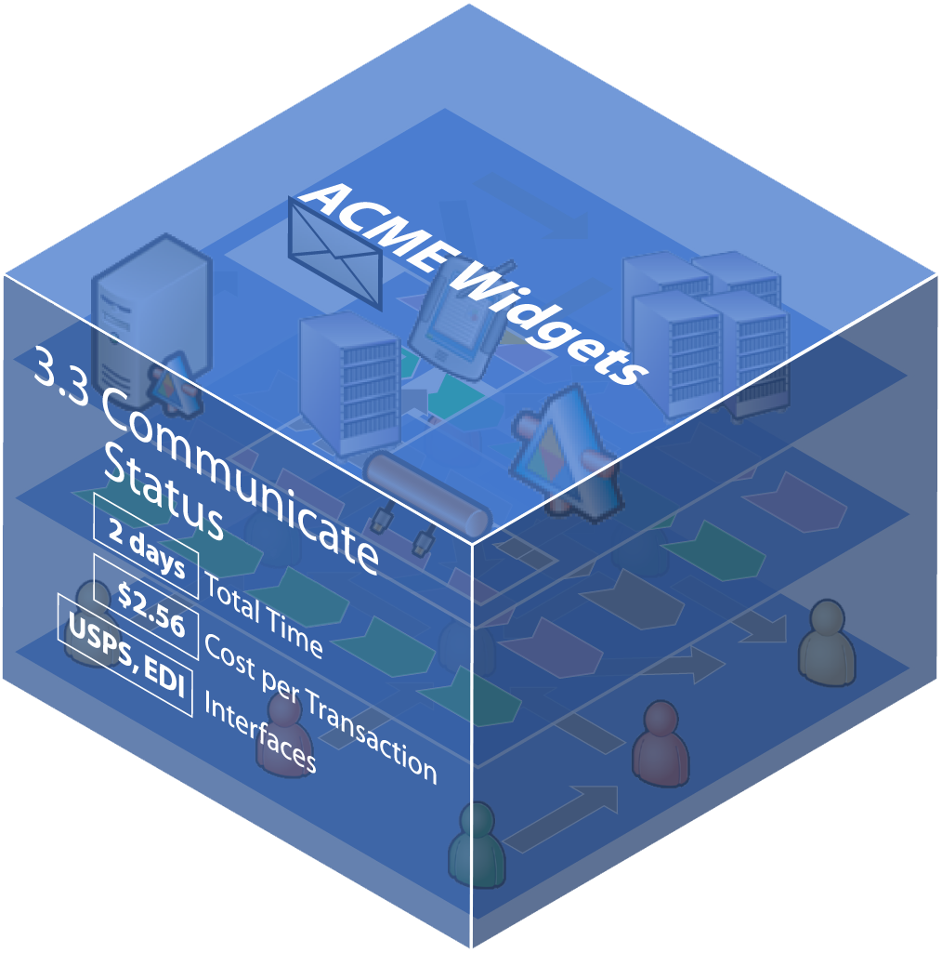
Detailing a Capability
Each capability encapsulates people, process and
Technology, plus many other relevant attributes
Up to 180 attributes can be captured for a capability:
Purpose
Owner
Segments
Stakeholders
Type
Sourcing
Location
Service level expectation

Slide 28
Capability Mapping can provide much more relevant information
Metrics – how is it measured?
Cost data
Service level (like a service level agreement with outsourcing) – how it is and how it should perform
Compliance and governance regulations
Owner
Customer
Does it directly contribute to the performance of the parent capability, or the department or the overall organization (core capability)
Is this capability a key part of what external organizations such as customers think of when they do business with the organization (identity/brand)

Slide 29
Examples out there

Slide 30
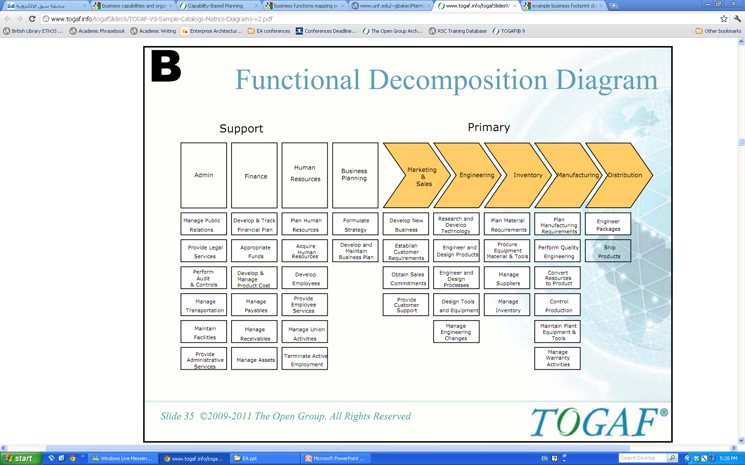
Manufacturing/retail - from TOGAF

Slide 31
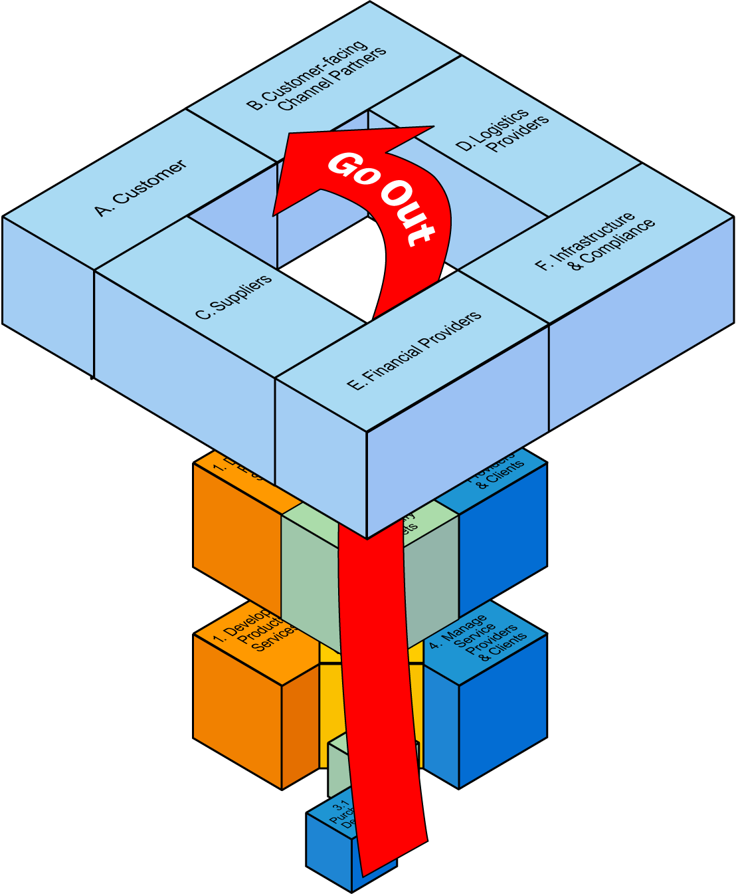
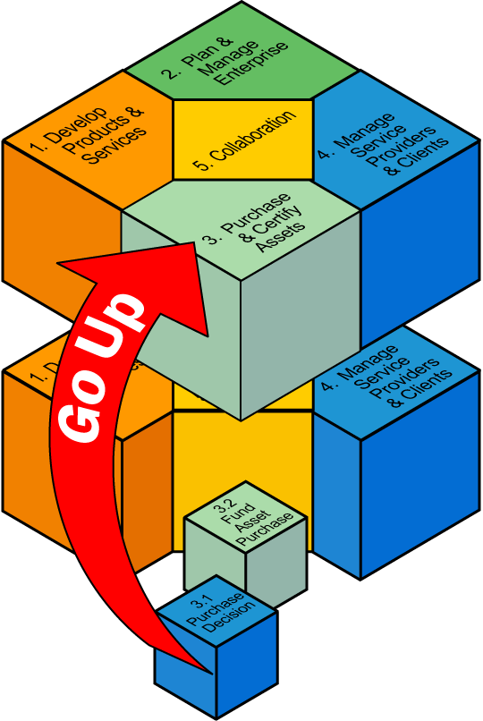
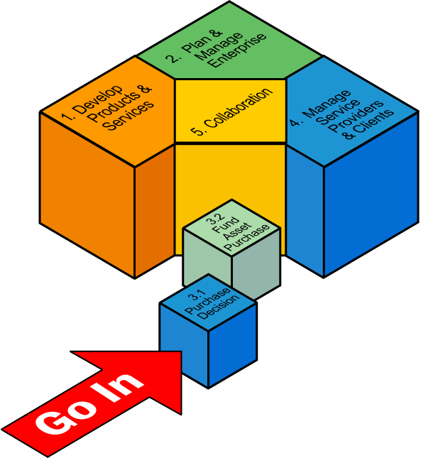
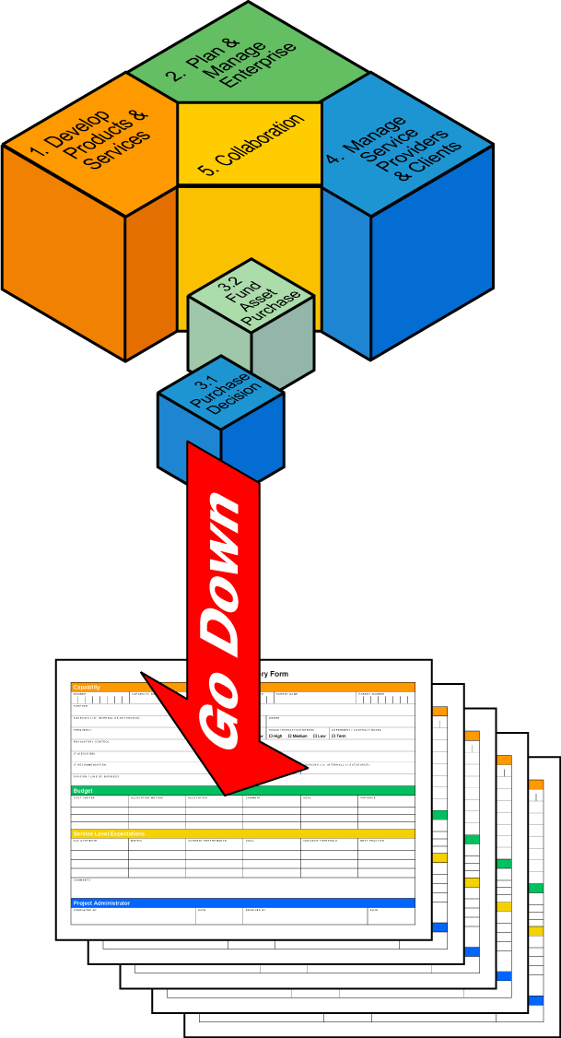
Microsoft Service Architecture Business
“Enables the analytical power of go-in, go-up,
go-out and only then… with that context, go-down”
Source: Graham Doig, “Microsoft Business Service Architecture (MBSA) – Getting Started with SOA”, Nov 2007, http://msdn.microsoft.com/en-us/architecture/aa902621
Notes:
Operational improvement is possible with conventional techniques, operational innovation – the invention of new models of work that yield strategic advantage is what is required (this is not possible without new analysis and design techniques and SOA to implement those designs)

Slide 32
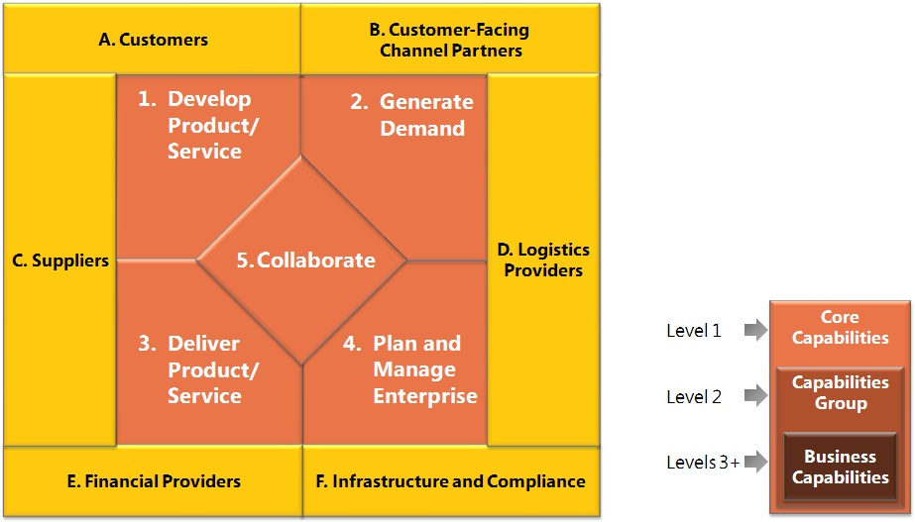
Microsoft Services Business Architecture (cont’d)
Source: Graham Doig, “Microsoft Business Service Architecture (MBSA) – Getting Started with SOA”, Nov 2007, http://msdn.microsoft.com/en-us/architecture/aa902621
Notes:
The capabilities that appear outside of the diagram are known as the environmental constituents.
These represent entities that are outside of the direct control of the organization and generally are provisioned by other organizations.
In most cases, these entities are not detailed and include only the capabilities that are needed.

Slide 33
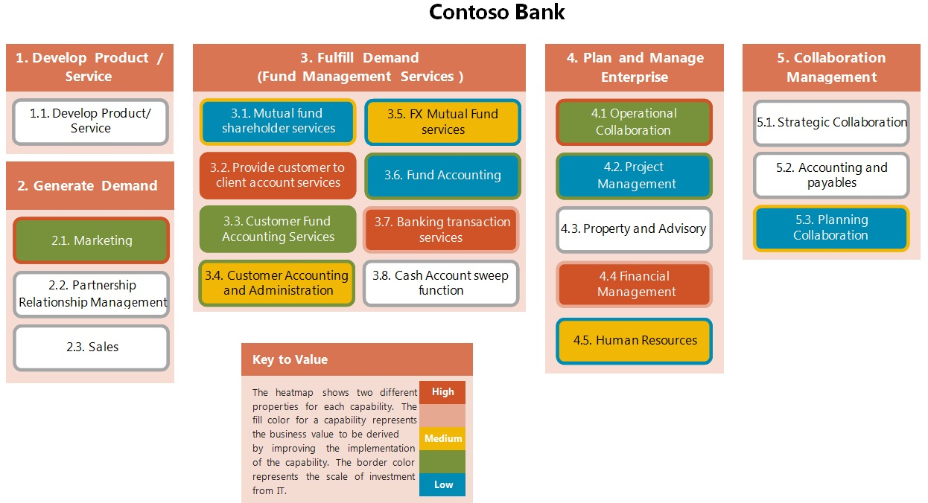
Microsoft Business Services Architecture (cont’d)
Source: Graham Doig, “Microsoft Business Service Architecture (MBSA) – Getting Started with SOA”, Nov 2007, http://msdn.microsoft.com/en-us/architecture/aa902621

Slide 34
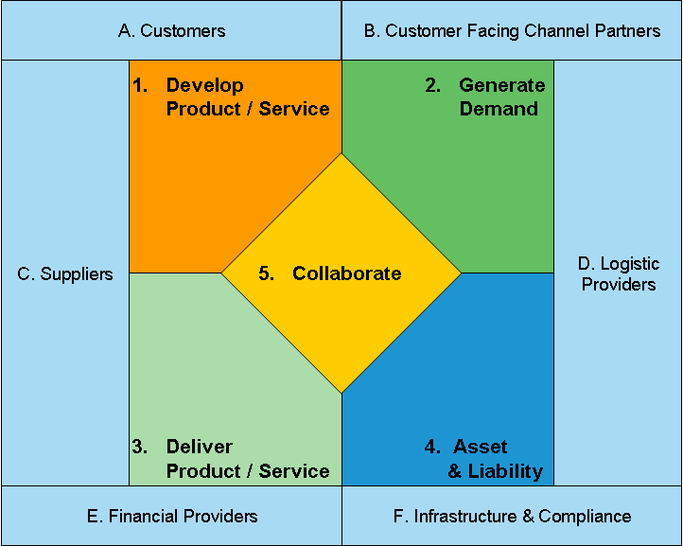
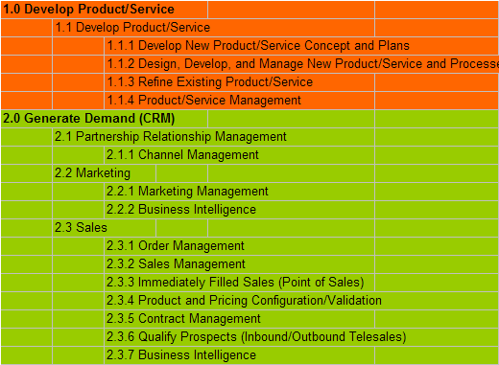
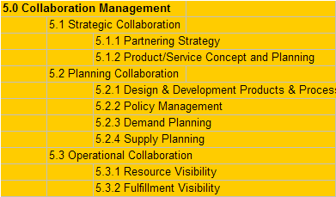
Microsoft Business Services Architecture (cont’d)
Capability Map
Source: Graham Doig, “Microsoft Business Service Architecture (MBSA) – Getting Started with SOA”, Nov 2007, http://msdn.microsoft.com/en-us/architecture/aa902621

Slide 35
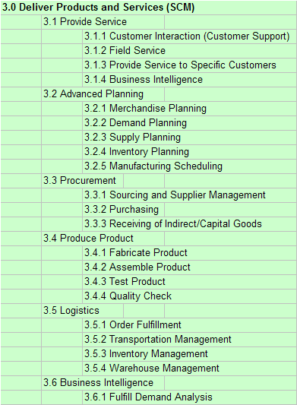
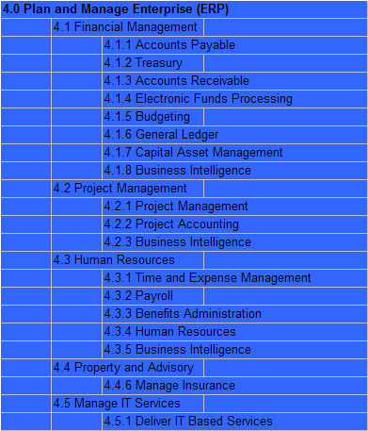
Microsoft Business Services Architecture (cont’d)

Slide 36
Microsoft Business Services Architecture (cont’d)
Purpose
Owner
Sourcing
Affiliation
Location
Type
Differentiating
Process Reuse
Source
Version
Customer
Customer Of
Processes) that use the Capability
Dependency Capability(ies)
Collaborative Capability(ies)
Number of Dependencies
Number of Dependent Capabilities
Number of Collaborative Interactions
Customer Satisfaction
SLA / SLE Details
Positive Variance Escalation Contact
Positive Variance Notification Threshold
Negative Variance Escalation Contact
Negative Variance Notification Threshold
Succession Plan
Schedule Dependency
Agreement / Contract Based
Agreements / Contracts Details
Past Performance
Desired Performance
Best Practice Comparison
Variability
Volatility
Human Interaction
Value Add
Process Variance
Exceptions
Electronic
Input
Output
Data Used - Reference
Data Used - Resource
Data Used - Activity
Triggering / Animating Function(s)
Artifact(s) / Document(s) Created
Security
Functional Complexity
Interface Complexity
Passive / Active
Request / Response On Inputs
Offer / Acceptance at the Outset of the Capability
Trigger Event
Source Capability(ies)
Content
Filter
Role
Role Quantity
Size
Vertical
Traditionally Outsourced
Regulation-driven
General

Slide 37

Microsoft Business Services Architecture (cont’d)
Business Model
Business/IT Alignment
Technology Independent
Services by Design
A. Customers
B. Customer Facing Channel Partners
C. Suppliers
Develop
Product / Service
Generate
Demand
D. Logistic
Providers
Collaborate
Demand
Plan & Manage
the Enterprise
Deliver
Product / Service
E. Financial Providers
F. Infrastructure & Compliance
Supply
Business Driven
Stable
Data Rich
Service
Model
Source: Graham Doig, “Microsoft Business Service Architecture (MBSA) – Getting Started with SOA”, Nov 2007, http://msdn.microsoft.com/en-us/architecture/aa902621

Slide 38
Microsoft Business Services Architecture (cont’d)
Capital Markets
Retail
Microsoft has developed a Generic Capability Model with around 2000 capabilities
Specialised for a number of industry specific models
Legal
Retail Banking
Human Resources
Insurance
Manage IT Services

Slide 39
Supply Chain Operations Reference Model (SCOR) – Supply Chain Council
Plan
Plan
Plan
Deliver
Source
Make
Deliver
Source
Make
Deliver
Source
Make
Deliver
Source
Return
Return
Return
Return
Return
Return
Return
Return
Supplier’s Supplier
SUPPLIER
CUSTOMER
Customer’s Customer
YOUR ORGANIZATION
Internal or External
Internal or External
Source: SCOR web site, http://supply-chain.org/SCOR-overview
Notes:
To define this in the way of principles of capabilities from A – G
SCOR – Supply Chain Operations Reference

Slide 40
SCOR contains three levels of process detail
In Scope Applicable across Industries | Level | Application | Examples
 | 1 | Level 1 processes are used to describe the scope and high level configuration of a supply chain. SCOR has five level 1 processes. | Plan, Source, Make, Deliver and Return
 | 2 | Level 2 processes differentiate the strategies of the level 1 processes. Both the level 2 processes themselves as well as their positioning in the supply chain determine the supply chain strategy. SCOR contains 26 level 2 processes. | Example Make level 2 processes: Make-to-Stock Make-to-Order Engineer-to-Order
 | 3 | Level 3 processes describe the steps performed to execute the level 2 processes. The sequence in which these processes are executed influences the performance of the level 2 processes and the overall supply chain. SCOR contains 185 level 3 processes. | Example Make-to-Order level 3 processes: Schedule Production Activities Issue Product Produce and Test Package Stage Dispose Waste Release Product
Not in Scope Industry Specific | 4 | Level 4 processes describe the industry specific activities required to perform level 3 processes. Level 4 processes describe the detailed implementation of a process. SCOR does not detail level 4 processes. Organizations and industries develop their own level 4 processes. | Example Issue Product level 4 processes for the electronics industry: Print Pick List Pick Items (Bin) Deliver Bin to Production Cell Return Empty Bins to Pick Area Close Pick Order
Source: SCOR web site, http://supply-chain.org/SCOR-overview
Notes:
SCOR for Business Architecture

Slide 41
SCOR process model
sP PLAN |  |  |  |  |  | sS SOURCE
sP1 Plan Supply Chain | sP2 Plan Source | sP3 Plan Make |  | sP4 Plan Deliver | sP5 Plan Return | sS1 Source Stocked Product | sS2 Source Make-to-Order Product |  | sS3 Source Engineer-to-Order-Product
sP1.1: Identify, Prioritize, and Aggregate Supply Chain Requirements sP1.2: Identify, Prioritize, and Aggregate Supply Chain Resources sP1.3: Balance Supply Chain Resources with Supply-Chain-Requirements sP1.4: Establish and Communicate Supply Chain Plans | sP2.1: Identify, Prioritize, and Aggregate Product Requirements sP2.2: Identify, Assess, and Aggregate Product Resources sP2.3: Balance Product Resources with Product Requirements sP2.4: Establish Sourcing Plans | sP3.1: Identify, Prioritize, and Aggregate Product ion Requirements sP3.2: Identify, Assess, and Aggregate Product ion Resources sP3.3: Balance Production Resources with Production Requirements sP3.4: Establish Production Plans |  | sP4.1: Identify, Prioritize, and Aggregate Delivery Requirements sP4.2: Identify, Assess, and Aggregate Delivery Resources sP4.3: Balance Delivery Resources with Delivery Requirements sP4.4: Establish Delivery Plans | sP5.1: Identify, Prioritize, and Aggregate Return Requirements sP5.2: Identify, Assess, and Aggregate Return Resources sP5.3: Balance Return Resources with Return Requirements sP5.4: Establish and Communicate Return Plans | sS1.1: Schedule Product Deliveries sS1.2: Receive Product sS1.3: Verify Product sS1.4: Transfer Product sS1.5: Authorize Supplier Payment | sS2.1: Schedule Product Deliveries sS2.2: Receive Product sS2.3: Verify Product sS2.4: Transfer Product sS2.5: Authorize Supplier Payment |  | sS3.1: Identify Sources of Supply sS3.2: Select Final Supplier(s) and Negotiate sS3.3: Schedule Product Deliveries sS3.4: Receive Product sS3.5: Verify Product sS3.6: Transfer Product sS3.7: Authorize Supplier Payment
sEP Enable Plan |  |  |  |  |  | sES Enable Source
sEP.1: Manage Business Rules for Plan Processes sEP.2: Manage Performance of Supply Chains sEP.3: Manage Plan Data Collection sEP.4: Manage Integrated Supply Chain Inventory sEP.5: Manage Integrated Supply Chain Capital Assets |  |  | sEP.6: Manage Integrated Supply Chain Transportation sEP.7: Manage Planning Configuration sEP.8: Manage Plan Regulatory Requirements and Compliance sEP.9: Manage Supply Chain Risk sEP.10: Align Supply Chain Unit Plan with Financial Plan |  |  | sES.1: Manage Sourcing Business Rules sES.2: Access Supplier Performance sES.3: Maintain Source Data sES.4: Manage Product Inventory sES.5: Manage Capital Assets |  | sES.6: Manage Incoming Product sEs.7: Manage Supplier Network sES.8: Manage Import/Export Requirements sES.9: Manage Supply Chain Source Risk SES.10: Manage Supplier Agreements
Source: SCOR web site, http://supply-chain.org/SCOR-overview

Slide 42
sM MAKE |  |  | sD DELIVER |  |  |  | sR RETURN
sM1 Make-to-Stock | sM2 Make-to-order | sM3 Engineer-to-order | sD1 Deliver Stocked Product | sD2 Deliver Make-to-order Product | sD3 Deliver Engineer-to-order Product | sD4 Deliver Retail Product | sSR1 Source Return Defective Product | sSR2 Source Return MRO Product | sSR3 Source Return Excess Product
sM1.1: Schedule Production Activities sM1.2: Issue Product sM1.3: Produce and Test sM1.4: Package sM1.5: Stage Product sM1.7: Waste Disposal | sM2.1: Schedule Production Activities sM2.2: Issue Product sM2.3: Produce and Test sM2.4: Package sM2.5: Stage Finished Product sM2.6: Release Finished Product to Deliver sM2.7: Waste Disposal | sM3.1: Finalize Production Engineering sM3.2: Schedule Production Activities sM3.3: Issue Product sM3.4: Produce and Test sM3.5: Package sM3.6: Stage Finished Product sM3.7: Release Product to Deliver | sD1.1: Process Inquiry and Quote sD1.2: Receive, Enter and Validate Order sD1.3: Reserve Inventory and Determine Delivery Date sD1.4: Consolidate Offers sD1.5: Build Loads sD1.6: Route Shipments sD1.7: Select Carriers and Rate Shipments | sD2.1: Process Inquire and Quote sD2.2.: Receive, Configure, Enter and Validate Order sD2.3: Reserve Inventory and Determine Delivery Date sD2.4: Consolidate Order sD2.5: Build Loads sD2.6: Route Shipments sD2.7: Select Carriers and Rate Shipment | sD3.1: Obtain and Respond to RFP/RFQ sD3.2.: Negotiate and Receive Contract sD3.3: Enter Order, Commit Resources, and Launch Program sD3.4: Schedule Installation sD3.5: Build Loads sD3.6: Route Shipments sD3.7: Select Carriers and Rate Shipment | sD4.1: Generate Stocking Schedule sD4.2: Receive Product at the Store sD4.3: Pick Product from Backroom sD4.4: Stock Shelf sD4.5: Fill Shopping Cart sD4.6: Checkout sD4.7: Deliver and/or Install | sSR1.1: Identify Defective Product Condition sSR1.2: Disposition Defective product sSR1.3: Request Defective Product Return Authorization sSR1.4: Schedule Defective Product Shipment sSR1.5: Return Defective Product | sSR2.1: Identify MRO Product Condition sSR2.2: Disposition MRO Product sSR2.3: Request MRO Return Authorization sSR2.4: Schedule MRO Shipment sSR2.5: Return MRO Product | sSR3.1: Identify Excess Product Condition sSR3.2: Disposition Excess Product sSR3.3: Request Excess Product Return Authorization sSR3.4: Schedule Excess Product Shipment sSR3.5: Return Excess Product

Slide 43
sM MAKE |  |  | sD DELIVER |  |  |  | sR RETURN
sM1 Make-to-Stock | sM2 Make-to-order | sM3 Engineer-to-order | sD1 Deliver Stocked Product | sD2 Deliver Make-to-order Product | sD3 Deliver Engineer-to-order Product | sD4 Deliver Retail Product | sSR1 Source Return Defective Product | sSR2 Source Return MRO Product | sSR3 Source Return Excess Product
 |  | Deliver sM3.8: Waste Disposal | sD1.8: Receive Product from Source or Make sD1.9: Pick Product sD1.10: Pack Product s.D1.11: Load Vehicle and Generate Shipping Docks sD1.12: Ship Product sD1.12: Ship Product sD1.13: Receive and Verify Product by Customer sD1.14: Install Product sD1.15: Invoice | sD2.8: Receive Product from Source or Make sD2.9: Pick Product sD2.10: Pack Product sD2.11: Load Product and Generate Shipping Docks sD2.12: Ship Product sD2.13: Receive and Verify Product my Customer sD2.14: Install Product sD2.15: Invoice | sD3.8: Receive Product from Source or Make sD3.9: Pick Product sD3.10: Pack Product sD3.11: Load Product and Generate Shipping Docks sD3.12: Ship Product sD3.13: Receive and Verify Product my Customer sD3.14: Install Product sD3.15: Invoice
 |  |  |  |  |  |  | sDR1 Deliver Return Defective Product | sDR2 Deliver Return MRO Product | sDR3 Deliver Return Excess Product
 |  |  |  |  |  |  | sDR1.1: Authorize Defective Product Return sDR1.2: Schedule Defective Return Receipt sDR1.3: Receive Defective Product (includes Verify) sDR1.4: Transfer Defective Product | sDR2.1: Authorize MRO Product Return sDR2.2: Schedule MRO Return Receipt sDR2.3: Receive MRO Product sDR2.4: Transfer MRO Product | sDR3.1: Authorize Excess Product Return sDR3.2: Schedule Excess Return Receipt sDR3.3: Receive Excess Product sDR3.4: Transfer Excess Product

Slide 44
sEM Enable Make |  |  |  | sED Enable Deliver |  |  |  | sER Enable Return
sEM.1: Manage Production Rules sEM.2: Manage Production Performance sEM.3: Manage Make Information sEM.4: Manage in-Process Products (WIP) sEM.5: Manage Make Equipment and Facilities |  | sEM.6: Manage Transportation (WIP) sEM.7: Manage Production Network sEM.8: Manage Make Regulatory Environment sEM.9: Manage Supply Chain Make Risk |  | sED.1: Manage Deliver Business Rules sED.2: Assess Delivery Performance sED.3: Manage Delivery Information sED.4: Manage Finished Goods Inventory sED.5: Manage Deliver Capital Assets |  | sED.6: Manage Transportation sED.7: Manage Product Life Cycle sED.8: Manage Import/Export Requirements sED.9: Manage Supply Chain Deliver Risk |  | sER.1: Manage Business Rules for Return Process sER.2: Manage Performance of Return Process sER.3: Manage Return Data Collection sER.4: Manage Return Inventory sER.5: Manage Return Capital Assets |  | sER.6: Manage Return Transportation sER.7: Manage Return Network Configuration sER.8: Manage Return Regulatory Requirements and Compliance sER.9: Manage Supply Chain Return Risk

Slide 45
Steps to building Capability Map
Obtain capability references as starting points
Industry capability maps (e.g. BIAM)
BP reference models (e.g. SAP BP reference models) or hybrid BP/capability models (e.g. SCOR)
B2B industry standards (e.g. PIDX, CIDX, VICS)
Consultancy-supplied capability models
Enterprise inputs: org. charts, information asset definitions, value chain and stream models etc.
Draft organisation-specific level 1 CM
Common capability categories: Customer and stakeholder management, account, policy, contract or similar management; investments, marketing and other strategic management, industry-specific categories like claims, routing or money management; support capabilities like accounting, HR, IT and legal

Slide 46
Steps to building Capability Map (cont’d)
3. Finalise level 1 CM around core team and stakeholders
Senior business reps from each LOB should be included in steering committee
Review draft level 1 CM
Establish definitions for capabilities from an information “lens” (descriptive parts like product, money, account)
Rationalise capability names across LOBs and divisions (e.g. policy versus contract)
Do gap analysis
4. Solicit wider input for level 1 CM
5. Establish level 2 capability priorities
Focus on strategic and value-added capabilities first (then focus on support capabilities)
Strategic capabilities could be decomposed at the directive of management initiatives
Notes:
Solicit - request

Slide 47
Steps to building Capability Map (cont’d)
6. Decompose level 2 capabilities
Work sessions per level 1 capability
Ensure all LOBs are represented (e.g. retail procurements, wholesale procurements, sell-from stock, make-from-stock, in-house asset transportation 3rd party logistics)
Level 3 decomposition may be achieved with same teams
Detailed information asset views may be useful
7. Establish level 3 capability decomposition priorities
Obtain business priorities, strategies and directives as guide from executive
Avoid “bias” in capabilities, e.g. key ERP roll-outs priority could imbalance detailed conceptions for full range of level 3 capabilities
8. Decompose level 3 capabilities

Slide 48
Steps to building Capability Map (cont’d)
9. Socialise and refine overall CM
Reconcile capabilities up/down/across CM, ensuring capability principles are met
10. Publish and maintain CM
Publish priority and well-developed capabilities ahead of full development
Create governance regime
Provide on-going validation with LOBs, IT projects etc
Notes:
Reconcile – make one thing compatible with another

Slide 49
Agenda
Introduction to business capabilities
Principles of capabilities
Capability maps
Capabilities and business/IT analysis
Introduction to business capabilities
Principles of capabilities
Capability maps
Capabilities and business/IT analysis

Slide 50
Discerning capabilities
Functional perspective
alludes to capabilities of an organization
Solid basis for strategic, tactical and operational alignment
Can get caught into how of organizational work
Can lead to stovepipes: redundancies and bias in capabilities
Use org/resource and functional perspectives to locate or scope capabilities and information perspective to conceptualise
Notes:
Discern – see or hear differences
Discern – perceive or understand

Slide 51
From business to IT levels through capabilities
Capability to org. unit
Capability and org. unit to whole value stream
Capability to stage of value stream
Capability to business objects
Stage of value stream to business service and business process mapping
Business process, business service, detailed capability to applications – IT services
IT services to SOA application stack

Slide 52
Capability mapping to org. units
Capability map to org. units and value chain models allows highest org. context for capabilities – horizontally shared capabilities
Can overcome misaligned conceptions and definitions of same fundamental capability

Slide 53
Organization-unit-to-business-capability mapping
Claims Management
Accounting Management
Reserves Management
Investment Management
Property & Purchasing
Product Management
Marketing Management
Marketing
Finance
Life & Disability
Payment Management
HR
ABC Insurance
HR Management
Health
Account Management
Legal
Purchasing
IT
Key
Customer Management
Legal Management
Enterprise
Business Unit
Procurement Management
Value-Add Capabilities
Information Technology
Strategic Capabilities
Supporting Capabilities

Slide 54
Value stream example
Acquire Product
Inquiry
Apply for Product
Accept application
Register & Deliver Product
Notify Customer
Manage Payment

Slide 55
Capability, value stream, business process mappings
Capabilities
(Levels 1-3)
Processes
(Levels 1-n)
1
2
3
Level 1 Mapping
Level 1 capability maps to value stream
Level 3 capability maps to value stream stage
Value stream stage maps to business process
Value Stream

Slide 56

The role of business capabilities in EA
Enterprise Architecture
Other applications
Business
Information
Infrastructure
Application
Technology
Capabilities
Business Entities
Business Processes
1
2
SOA Business and Information Services
3
Level 1
Mapping
Integration Services
IS
IS
IS
IS
IS
IS
IS
Operational Resources
Value Stream
SOA Reference Architecture
Notes:
NOT EXAM

Slide 57
Capability to application architecture mapping
Partner Management
Vendor Management
Vendor Information Management
Vendor Information Addition
Vendor Information Update
Example of Capability Level 4 Decomposition
Vendor Information Deletion
Vendor Contact Management
Vendor Contact Notification
Vendor Contact Inquiry

Slide 58
Capability mapping to future-state architecture
Current State
Future State
Gaps: ?
Capabilities are not implemented
Redundancy
The same capability is implemented by multiple systems
Overlaps
Some systems implement multiple capabilities
Notes:
Gaps = capabilities are not implemented
Redundancy = the same capability is implemented by multiple systems
Overlaps = some systems implement multiple capabilities

Slide 59
Capability, value stream, business mapping process to IT architecture
Applications and Services
User Interfaces
Capabilities
(Levels 1-3)
Processes
(Levels 1-n)
1
2
3
Level 1
Mapping
Level 1 capability maps to value stream
Level 3 capability maps to value stream stage
Value stream stage maps to business process
Value Stream
Notes:
Level 1 capability to value stream
Level 3 capability to value stream stage
Value stream stage maps to business process

Slide 60
Value stream-driven view of process alignment and automation
Value stream maps user/business interface as a basis for transforming process/workflow automation for internal and external stakeholders
Acquire Product
Inquiry
Apply for Product
Accept application
Register & Deliver Product
Notify Customer
Manage Payment
Product Display
Application Completion
Information Validation
Account Update
Notification Creation
Invoice
Investments
Reserves Management
Marketing
Payment Tracking
Customer Management
Product Browse
Application Receipt
Information Verification
Financial Update
Notification Issuance
Claims
Administration
Billing
Product Select
Receipt Notification
Acceptance Notification
Product Ship
Shipment Track
Payment Processing
Sales
Information Technology
Account Management
Account Update
HR
Procurement
Legal
Accounting
Financial Update
Capability Map

Slide 61
Capability-based transformation to back-end application architecture via modernization
Current-State Application
Target-State Design Models
Insured Employee
Object: From object data model
Trigger: Daily claim review process
Interim-State Application
Function
A
Function
B
Register Claim
Approve Claim
Function A
Function
A
Function
C
Trigger: Employee makes a claim
Precondition: Register claim
Function C
Function
D
Function
B
Function B
Target State Language
Function D
Notes:
Interim – the time between one process

Slide 62
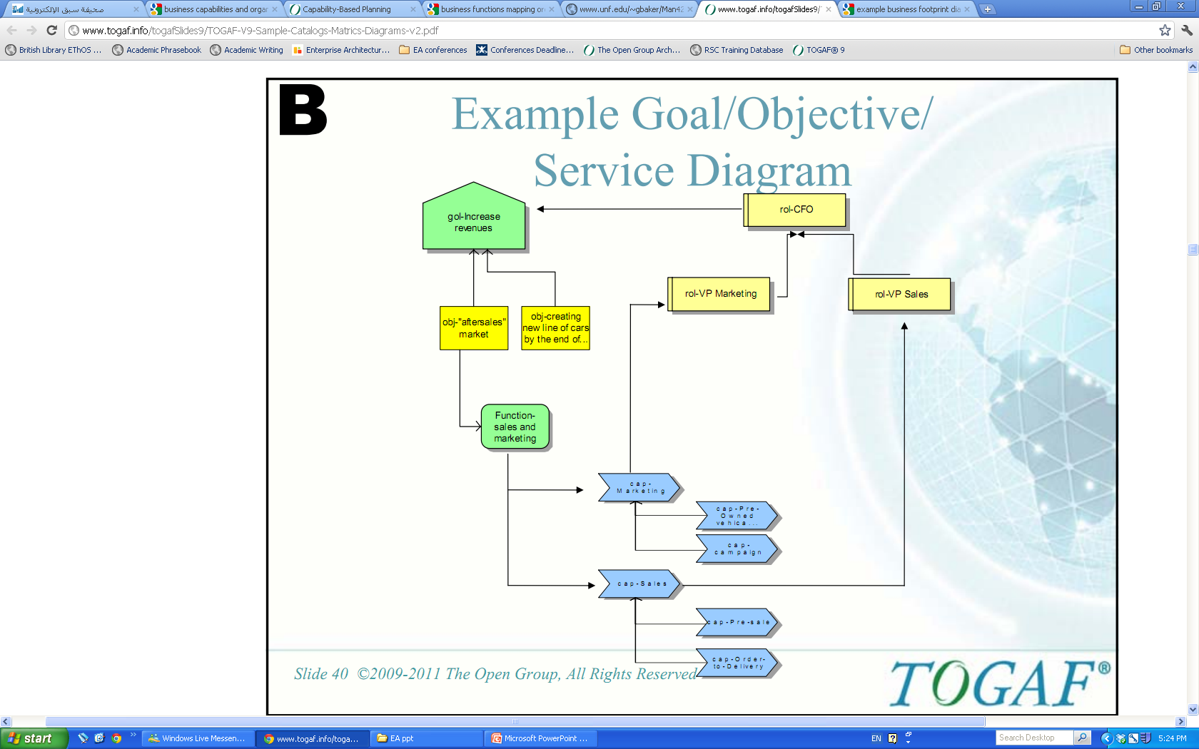
Goal/Objective & Service Diagram

Slide 63

Capability of capabilities: heat map analysis
Investment management
Money
management
Business areas & models mgmt.
Strategic partnerships management
Business policy
management
Marketing
management
Customer
management
Product
management
Service
management
Partner Management
Vendor Management
Manage Product Acquisition
Vendor Management
Manage Product Acquisition
Partner
management
Distribution Channel management
Account
management
Vendor Information Management
HR
management
Partner acquisition
management
Production
management
Vendor Contact Management
Warehouse
management
Financial
management
IT
management
Product Information Management
Product Request Management
Product Fulfilment Management
Heat map
analysis

Slide 64
Heat mapping a business capability
Partner Management
Vendor Management
Manage Product Acquisition
Vendor Management
Manage Product Acquisition
Vendor Information Management
Vendor Contact Management
Product Information Management
Product Request Management
Product Fulfilment Management

Slide 65
The colour coded boxes enable comparisons to be made between a selection of key dimensions related to the Capability
The border colour represents one dimension being compared
The body colour represents the second dimension being compared

Slide 66
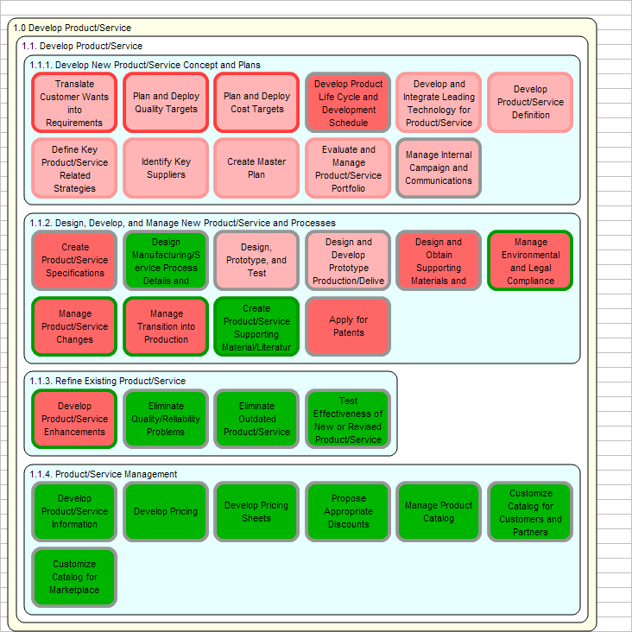
Once a Capability Map has been created it is possible to generate a Heat Map

Slide 67
Heat map classifications
Red
Highly likely in need of attention, or to be worthy of attention.
Pink
Likely to need attention
Yellow
Medium attention
Light Green
Unlikely to need attention
Green
Highly unlikely to need attention
Unknown
Unknown attention level - questions not answered

Slide 68
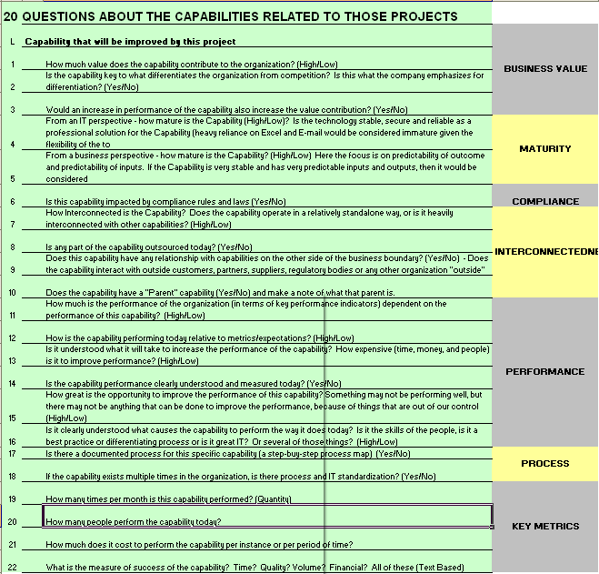
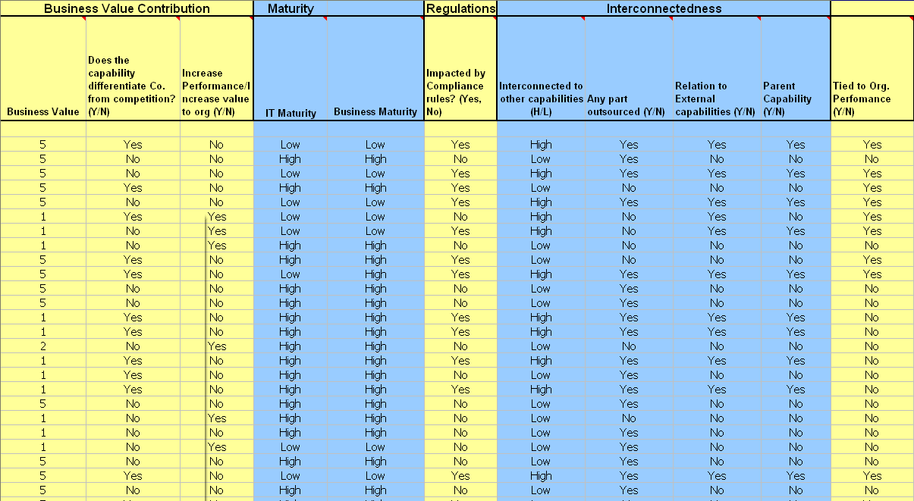
The Heat Map is created by asking the “20 Questions”

Slide 69

Questions, reflections, follow-ups

Slide 70

Prof. Alistair Barros
Smart Services CRC Chair for Services Science and Computing
School of Information Systems
Faculty of Science and Engineering
Queensland University of Technology
Email: alistair.barros@qut.edu.au
Skype: alistairbarros
Web: http://www.alistairbarros.com

